Slide 1
Poba Medical Final Presentation
Michael Bransky, Noah Keyes, Vergil Sorg

Slide 2

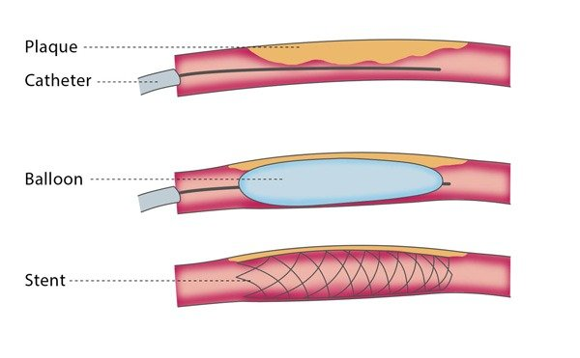
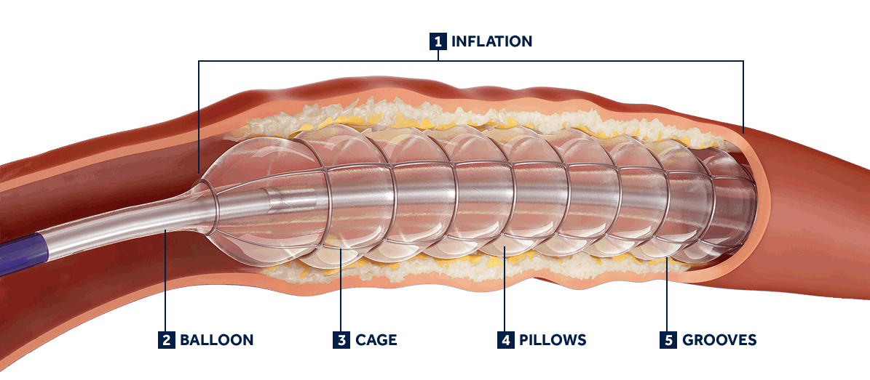
Project Description
Poba Medical wants our team to design and build a radial expansion tester, with controlled temperature and axial load, for the extruded plastic tubes used in the manufacture of their balloon catheters.

Slide 3
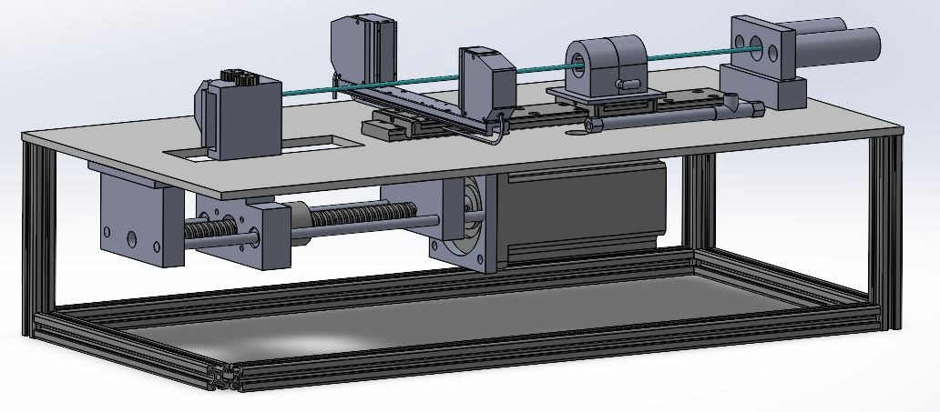
Design Description
Diameter Measurement
Clamping
Clamping/
Pressurization
‹#›
Vergil Sorg
11/1/2021
Radial Expansion Tester
Axial Loading
Heating

Slide 4
Design Description
Axial Loading system: Stepper motor driving ball screw attached to backing plate which carries the “stretching” side of the extrusion
Diameter Measurement: Optical micrometer mounted to a linear rail for ease of construction
Heating system: Heated air which flows through a nozzle that directs air over the extrusion, also mounted on a linear rail so that expansion can happen outside of nozzle.
Clamping system: Pneumatically actuated clamps provide quick ability to load multiple diameters without need for readjustment.
‹#›
Vergil Sorg
11/1/2021
Radial Expansion Tester

Slide 5
Design Requirements
Poba Medical wants a Radial Expansion Tester that can
Pressurize a plastic extrusion up to 300 psi
Apply up to 150 lbs of axial force with minimal slippage
Test unexpanded diameters of .2-.625”
Measure expanded diameters up to 2.5”
Control the temperature of a 2 inch length of extrusion up to 250℉
‹#›
Michael Bransky
11/1/2021
Radial Expansion Tester

Slide 6

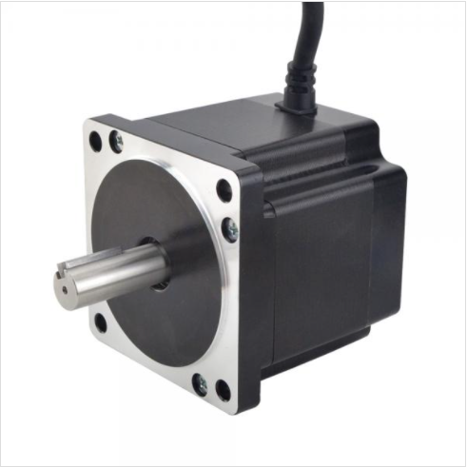

Design Requirements- Axial Loading System
F = 150 lbs = 667N
d_{m}= 8mm
d_{c} = 10mm
l = 2 mm
f = f_{c} = .15
T_{R} = 112 N-cm
‹#›
Michael Bransky
11/1/2021
Radial Expansion Tester

Slide 7
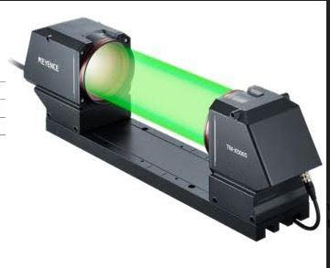
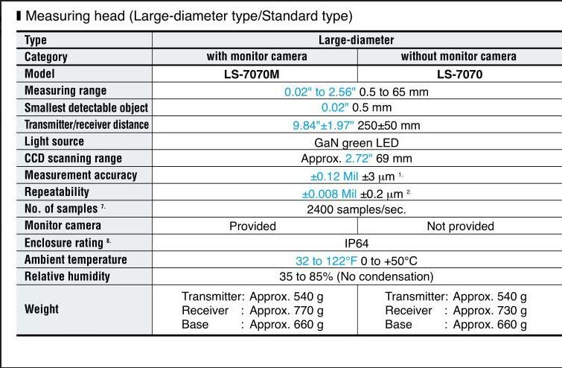
Design Requirements- Diameter Measurement
‹#›
Michael Bransky
11/1/2021
Radial Expansion Tester

Slide 8
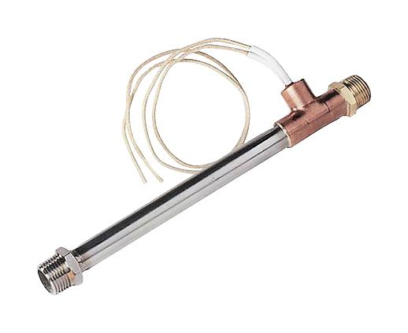
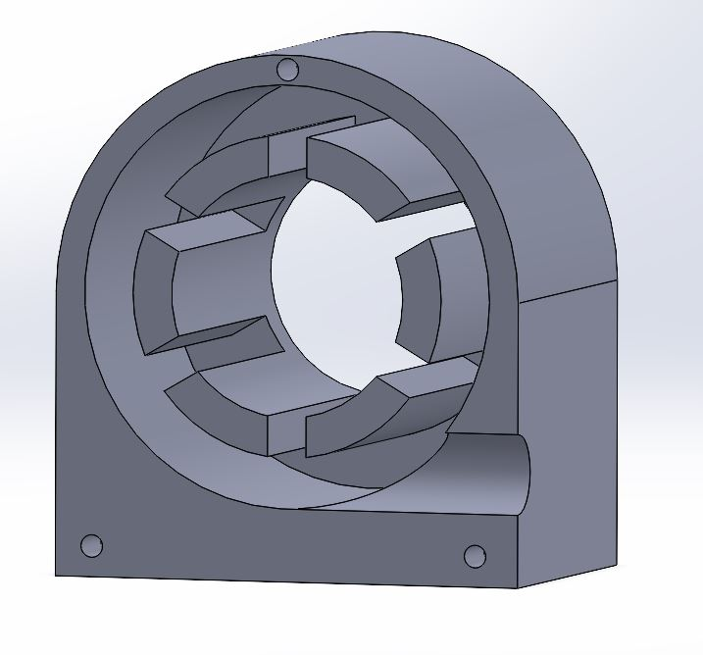
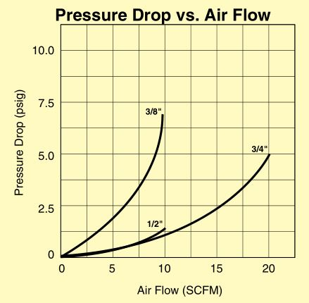
Design Requirements- Heating System
Heater has the ability to reach output air temp up to 1,000F
Custom made dispersion nozzle will allow uniform heating around extrusion
PID controller in combination with airflow regulator will allow us to have a wide range of possible heating parameters
Watts = SCFM * Dt / 3
4CFM * 200F/3 = 266 watts
‹#›
Vergil Sorg
11/1/2021
Radial Expansion Tester

Slide 9
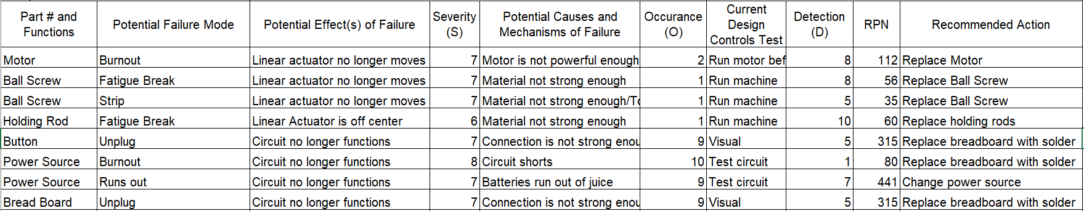
FMEA-Axial Load System
‹#›
Noah Keyes
11/1/2021
Radial Expansion Tester
Most failures have to do with breadboard or motor system
Breadboard will be replaced with a fully soldered system
System will be plugged into wall
DC motor will be replaced with a more powerful stepper motor
‹#›
Michael Bransky
11/1/2021
Radial Expansion Tester

Slide 10
Testing Procedures-Axial Load System
Testing Procedure | Purpose | Required Materials
Run the axial loading subsystem for long periods of time (up to 20 minutes) | Test power supply/fatigue wear on ball screw/ eccentricity of lead screw | Power supply, finished axial loading system
Stretch multiple nylon balloons | Test maximum axial force output of system | Power supply, finished axial loading system, nylon extrusion
Apply a variety of different voltages to motor | Test different forces that linear actuator can produce | Power supply, finished axial loading system, force sensor
Pop multiple balloons | Test how well system can take the shock of popping a balloon | Power supply, finished axial loading system, extrusion
‹#›
Michael Bransky
11/1/2021
Radial Expansion Tester

Slide 11
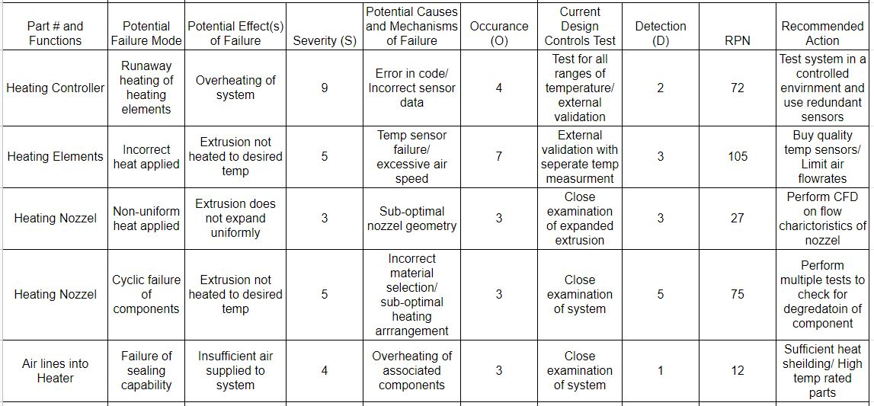
FMEA- Heating System
‹#›
Vergil Sorg
11/1/2021
Radial Expansion Tester

Slide 12
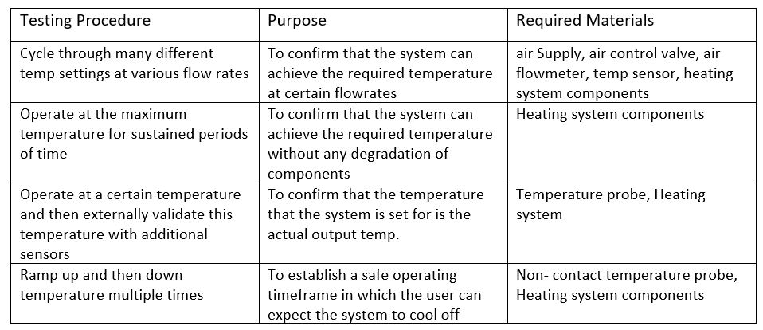
Testing Procedures- Heating System
‹#›
Vergil Sorg
11/1/2021
Radial Expansion Tester

Slide 13
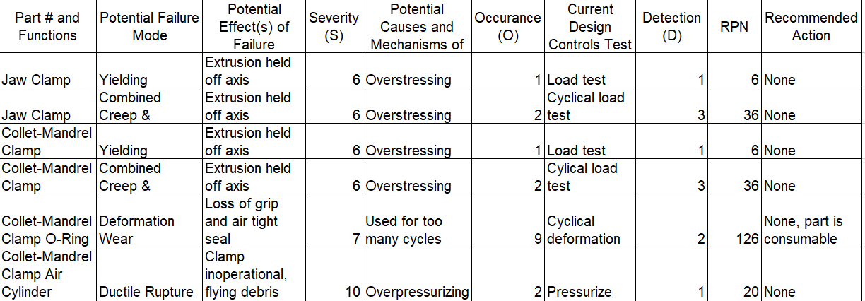
FMEA - Clamping System

Slide 14
Testing Procedure - Clamping
Testing Procedure | Purpose | Required Materials
Run the axial loading system for long periods of time with extrusion clamped into device | Check for yielding, creep, and low cycle fatigue in the clamps | Power supply, finished axial loading system, extrusion
Clamp extrusion with collet-mandrel clamp | Check for deformation wear in the collet-mandrel clamp O-ring | Air supply, pressure gauge, collet-mandrel clamp, extrusion
Pressurize collet-mandrel clamp air cylinders | Check cylinders for deformation and ductile rupture | Air supply, pressure gauge, collet-mandrel clamp

Slide 15
Schedule and Budget
Our schedule and budget have changed structure dramatically due to Poba’s management of this project.
Poba does not want to buy anything until they are convinced our design is adequate to be the final product.
This means they will not be buying us parts to be used for prototyping.
Our old schedule and budget, which were originally structured around prototyping each subsystem of the project, are now completely void.

Slide 16
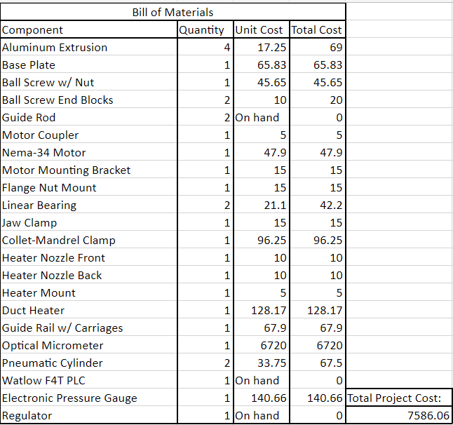
Budget
Without prototyping, our budget breaks down into two sections: cost of the final product and contingency fund.
With an estimated cost of $7,586.06 for the final product, the $2,413.94 remaining of our $10,000 budget will go to the contingency fund.
To date, no purchases have been made.

Slide 17
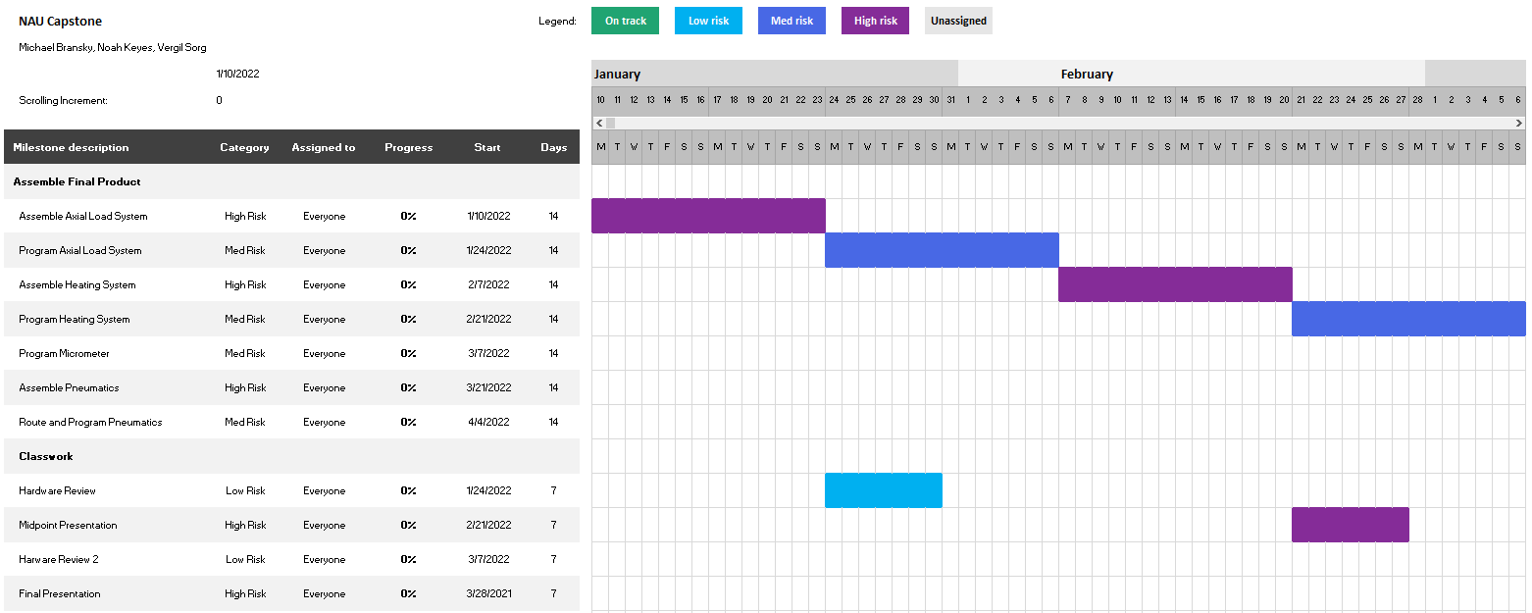
Schedule

Slide 18
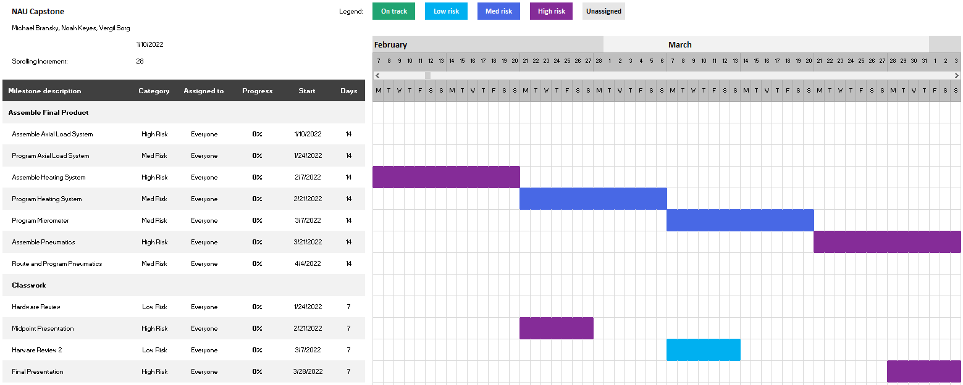
Schedule

Slide 19
Sources Cited
[1] “Amazon.com: Tevo Tarantula Dual z axis upgrade kit NEMA 42 ...” [Online]. Available: https://www.amazon.com/TEVO-Tarantula-Upgrade-Copper-Printer/dp/B073YMBNTC. [Accessed: 01-Nov-2021].
[2] “E series NEMA 34 Stepper Motor Bipolar 1.8deg 4.8 nm(679.87oz.in) 6.0a 86x86x80mm 4 wires,” STEPPERONLINE. [Online]. Available: https://www.omc-stepperonline.com/nema-34-stepper-motor/e-series-nema-34-stepper-motor-bipolar-1-8deg-4-8-nm-679-87oz-in-6-0a-86x86x80mm-4-wires.html. [Accessed: 01-Nov-2021].
[3] R. G. Budynas, J. K. Nisbett, and J. E. Shigley, Shigley's Mechanical Engineering Design. McGraw-Hill, 2016.

